Slide 1
O-LIST E-COMMERCE ANALYSIS
GROUP - 4

Slide 2
TEAM MEMBERS
Aishwarya K
Achal Dhote
Abhishek RT
Finaz Nadaf
Shilpa Dash
Ranjith Kumar
Amit Dubli

Slide 3
MENTORS
Kunal
Athul K

Slide 4
CONTENT
PROJECT PROCESS
RELATIONSHIP
KPI 1 ANALYSIS
KPI 2 ANALYSIS
KPI 3 ANALYSIS
KPI 4 ANALYSIS
KPI 5 ANALYSIS
EXCEL DASHBOARD
POWERBI DASHBOARD
TABLEAU DASHBOARD
CHALLENGES AND OVERCOMES

Slide 5
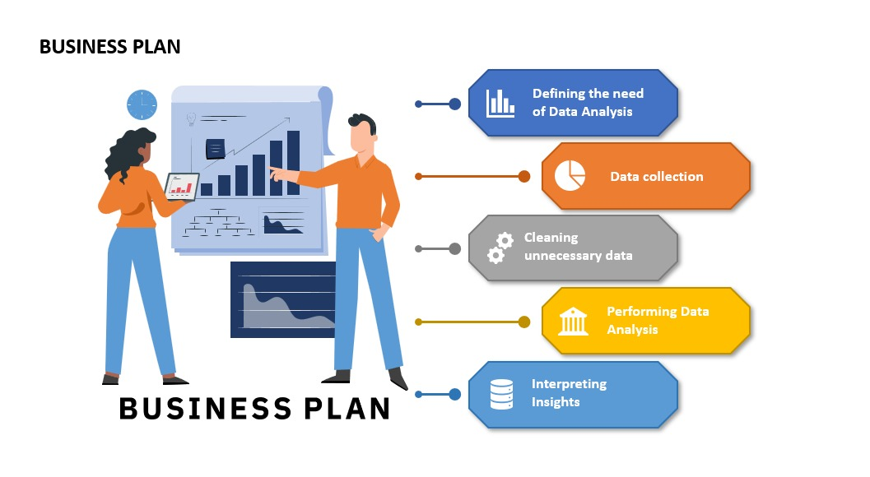
PROJECT PROCESS

Slide 6
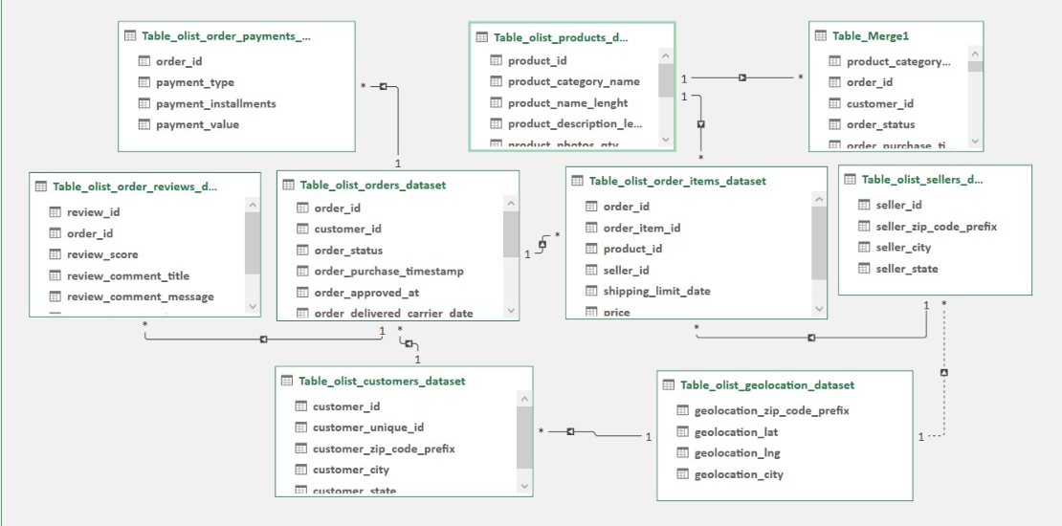
RELATIONSHIP BETWEEN DATASETS

Slide 7
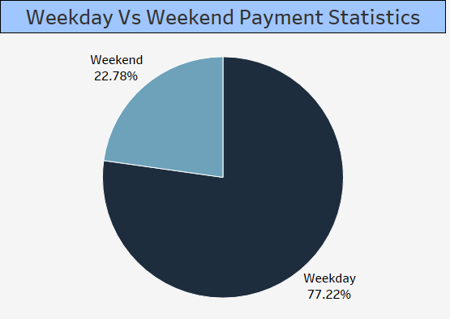
KPI 1 ANALYSIS
More payments on weekdays as compared to weekends.
People prefer to purchase more on Weekdays than Weekends as count of orders is high during weekdays.
To increase the sales on Weekend, E-commerce site can take steps to advertise/remind their products price by SMS, E-mails on weekends.

Slide 8
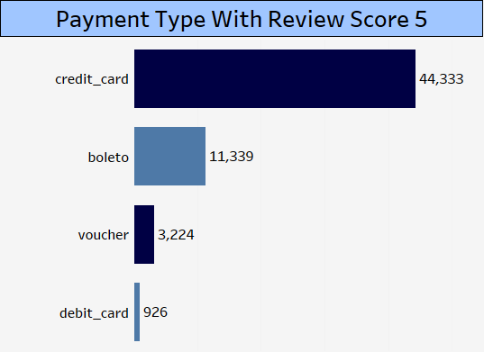
KPI 2 ANALYSIS
There are more numbers of credit card users.
Apart from credit card users there are many boleto users.
Discount can be given to the users purchasing through credit card.
Validity of Vouchers should begin early and have longer span.

Slide 9
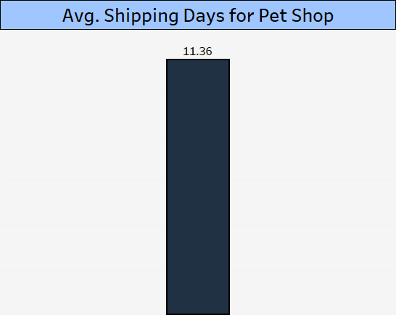
KPI 3 ANALYSIS
Pet Shop products are more sold in Sao Paulo and Rio cities.
Reducing shipping days can improve more purchase in Rio.
Setting up more pet clinics may increase the sales.

Slide 10
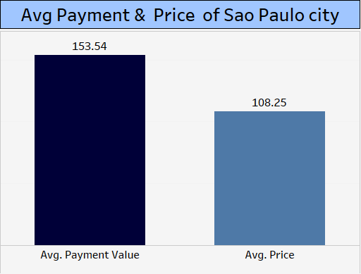
KPI 4 ANALYSIS
Sao Paulo is the highest paying city, hence people are in good jobs and city is well developed.
Possibility of high job opportunity.
Standard of living is high since price of products is high in Sao Paulo city.

Slide 11
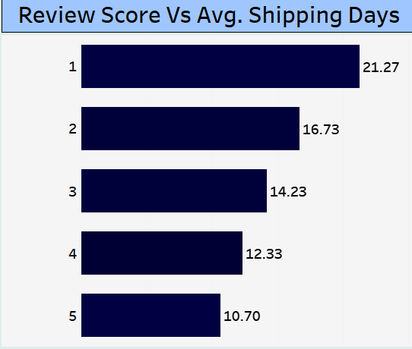
KPI 5 ANALYSIS
Lesser the duration of shipping higher the review score.
Freight value and duration of shipping both are more in rating 1.
Longer the shipping days products being delivered safely is at stake.
Product replacement with quick delivery may increase the rating.

Slide 12
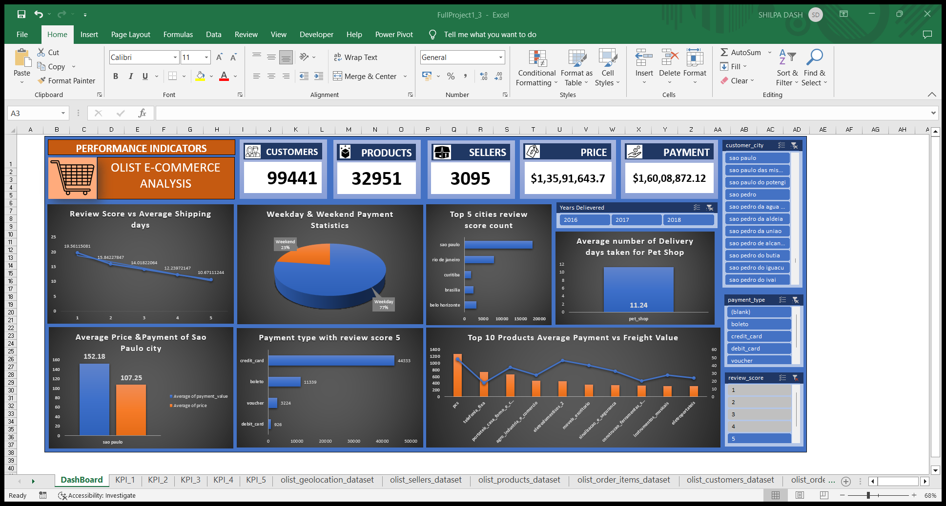
EXCEL DASHBOARD

Slide 13
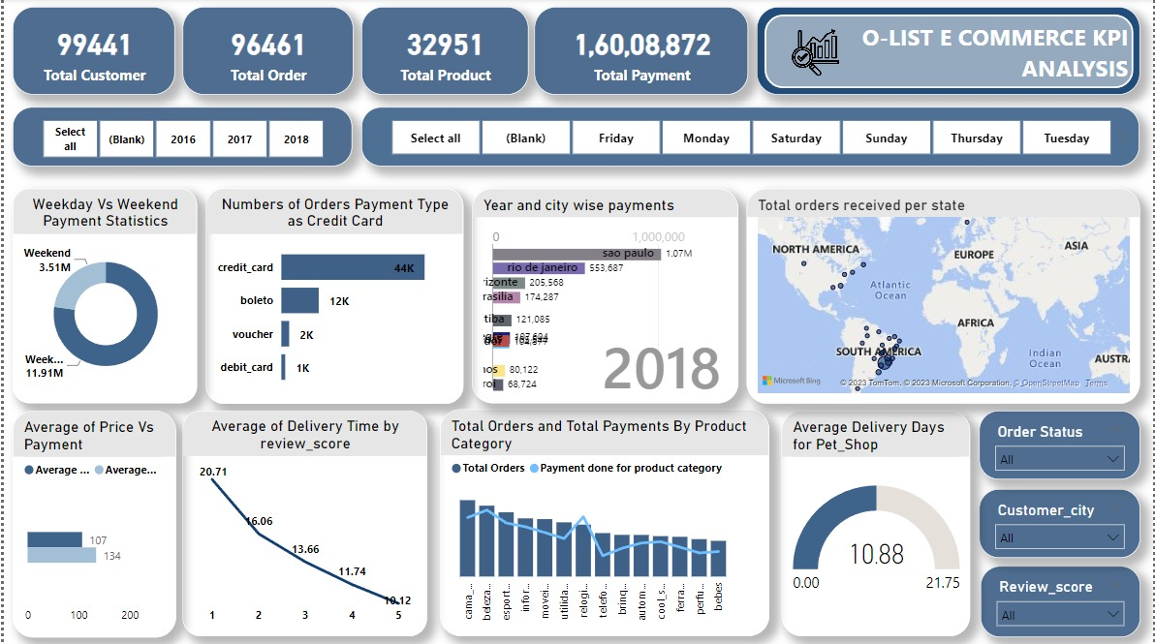
POWERBI DASHBOARD

Slide 14
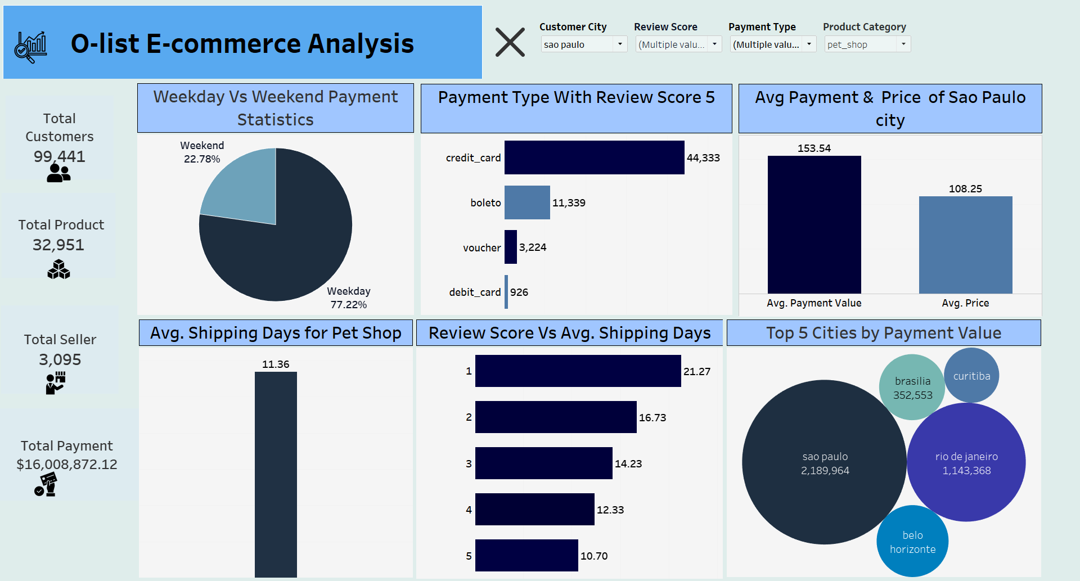
TABLEAU DASHBOARD

Slide 15
CHALLENGES AND OVERCOMES
Unlike PowerBi or Tableau, loading datasets from Power Query of Excel and Mysql took time. Treating the datasets helped to a considerable extent.
Finding the relationships between tables based on primary key would have taken time if not for the FlowChart.
Performing Joins were required to provide insightful observations.
Coordination as a team; Factors - Time, Geographical Reasons, Experience, Communication. To overcome, we had regular scrums everyday to get the work done and have atleast one or more reviews before final presentation.

Slide 16
THANK YOU

